Slide 1
Assignment #5 – Linear Regression Jay Panchal 100960958

Slide 2
Description of the Analysis
Context of Simple Linear Regression:
Simple Linear Regression is a statistical method used to understand the relationship between a single independent variable (predictor) and a dependent variable (outcome).It models the linear relationship by fitting a line to the observed data.
Specific Analysis:
In this analysis, we examine the effect of the predictor variable "sex" on the dependent variable "expenses.“ We aim to determine whether there is a statistically significant difference in expenses between males and females.

Slide 3
Hypothesis testing steps
Hypothesis Testing:
Null Hypothesis (H0): Sex does not significantly affect expenses.
Alternative Hypothesis (H1): Sex significantly affects expenses.
Significance Level:
The significance level (denoted as α) is the threshold at which we decide whether an observed effect is statistically significant. It represents the probability of rejecting the null hypothesis when it is actually true.
Application: In this analysis, we use a significance level of 0.05. If the p-value is less than 0.05, we reject the null hypothesis and conclude that there is a statistically significant effect.

Slide 4
Linear Regression Analysis:
The general form of the simple linear regression equation is:
expenses=𝛽0+𝛽1⋅sexexpenses=β 0​ +β 1​ ⋅ sex
Where,
β0​ is the intercept (the average value of expenses when the predictor variable is zero, in this case, for females).
𝛽1 is the coefficient of the predictor variable (the change in expenses for a one-unit change in the predictor variable, in this case, the difference in expenses between males and females).

Slide 5
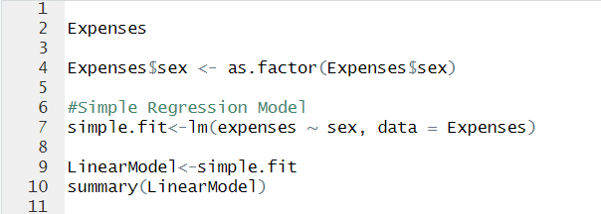
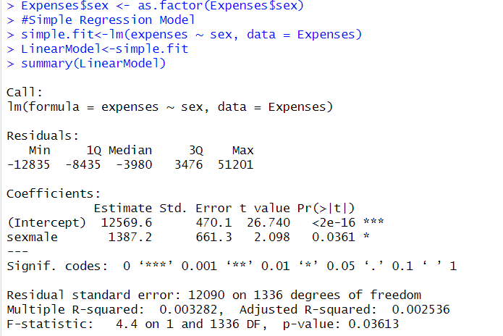
Conducting Analysis in r
Interpreting the Coefficients:
Intercept (𝛽0): 12569.6
This means that the average expenses for females are 12569.6 units.
Sex (male) coefficient (𝛽1): 1387.2
This means that males have, on average, 1387.2 units higher expenses compared to females.
Regression Equation :expenses=12569.6+1387.2⋅sex
expenses=12569.6+1387.2⋅sex
Here, "sex" is a binary variable (0 for females and 1 for males).
Therefore,
for males, the equation becomes: expenses=12569.6+1387.2=13956.8
For females, the equation remains:
expenses=12569.6

Slide 6
Conclusion:
Since the p-value (0.0361) is less than α (0.05), we reject the null hypothesis. This means that there is sufficient statistical evidence to conclude that sex significantly affects expenses.
Insights and Findings:
Statistical Significance:
The p-value for the variable "sex (male)" is 0.0361, which is less than the significance level of 0.05. This indicates that sex has a statistically significant effect on expenses.
Model Fit:
R-squared: 0.003282 - This means that sex explains only 0.3282% of the variability in expenses, indicating a very weak model fit.

Slide 7
Coefficient Interpretation:
Intercept (Female baseline): 12569.6 - This represents the average expenses for females.
Sex (male) coefficient: 1387.2 - This indicates that males have, on average, 1387.2 units higher expenses compared to females.
F-statistic: 4.4
This value tests the overall significance of the regression model. It compares the model with no predictors (intercept only) to the model with the predictor.
Adjusted R-squared: 0.002536
This adjusts the R-squared value for the number of predictors in the model. It is very close to the R-squared value, indicating that adding more predictors might not significantly improve the model fit.

Slide 8
Additional Variables to Improve Model Accuracy
Variable 1: Age
Reason for Inclusion: Age is likely to influence spending patterns. Older individuals may have different expense needs compared to younger individuals.
Expected Impact: Including age could help capture variability in expenses related to different life stages and priorities.
Variable 2: Income
Reason for Inclusion: Higher income levels often correlate with higher spending. Understanding the income levels can provide insights into spending capabilities.
Expected Impact: Including income as a variable could significantly enhance the predictive power of the model by accounting for financial capacity to incur expenses.

Slide 9
THANK YOU!

